Slide 1

DoD Enterprise DevSecOps Initiative Ask Me Anything Event
Mr. Nicolas Chaillan
Chief Software Officer, U.S. Air Force
Co-Lead, DoD Enterprise DevSecOps Initiative
V3.2 – UNCLASSIFIED

Slide 2
News!
New AF CSO email: af.cso@us.af.mil
Repo One and IronBank are now under Platform One SSO, if you need an account, go to: http://login.dsop.io/
New Platform One website: https://p1.dsop.io
New Iron Bank Front end: https://ironbank.dsop.io
New Harbor registry! https://registry1.dsop.io
Iron Bank now has 200+ containers approved!

Slide 3
CSO Website – Continuously Updated!
Want to find information about the DevSecOps initiative and the CSO?
Our latest documents/videos: https://software.af.mil/dsop/documents/
Our latest training videos/content at: https://software.af.mil/training/
Platform One Services: https://software.af.mil/dsop/services/
More information about :
Platform One On Boarding: https://software.af.mil/team/platformone/
Cloud One: https://software.af.mil/team/cloud-one/
Repo One: https://repo1.dsop.io
Iron Bank: https://ironbank.dsop.io
DevStar: https://software.af.mil/dsop/dsop-devstar/
Software Factories: https://software.af.mil/software-factories/
Our Events/News: https://software.af.mil/events/
.mil only IL4 Chat (MatterMost): https://chat.collab.cdl.af.mil/

Slide 4
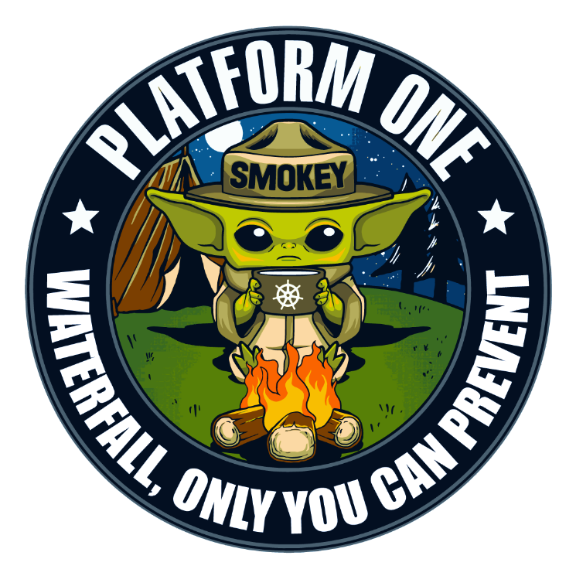










Software Ecosystem Multiple Innovation Hubs, One Platform
N2X Pathfinder
Colorado Springs, CO
Thunder CAMP
Oklahoma City, OK
Platform One
Colorado Springs, CO
Space CAMP
Colorado Springs, CO
NORAD
Rogue Blue
Omaha, NE
76th SWEG
JAIC
Army Cyber
AEGIS
F-35
ABMS
Space Force
STRATCOM
Kessel Run
Boston, MA
AOC
F-35
ABMS
SoniKube
Hill AFB, UT
Ski CAMP
Hill AFB, UT
F-16
Conjure
Scott AFB, IL
GBSD
375th
Kobayashi Maru
Los Angeles, CA
Blue Sky
Warner Robins, GA
SMC
402nd SWEG
Corsair Ranch
Tuscon, AZ
LevelUP
San Antonio, TX
BESPIN
Montgomery, AL
TRON
Oahu, HI
Unified Platform
PEO BES
PACOM

Slide 5
DSAWG DevSecOps Subgroup
Voting members:
SAF/CSO (chair), DoD CIO/DISA and A&S
Sub groups:
Team 1: DoD Enterprise DevSecOps Ref Design (and following updates)
Team 2: Kubernetes SRG
Team 3: Containers SRG
Team 4: Cloud Native Access Point
Team 5: Work with NIST (Ron Ross) on DevSecOps new publication based on Ref Design.
Team 6: Continuous ATO Guidance, defining the:
Accreditation requirements to accredit DevSecOps pipeline process and the various layers
Accreditation requirements to accredit teams to use the accredited pipelines
The expected deliverables / artifacts of pipelines/platforms + automation eMass etc.
Team 7: Write the required training for SCAs and ISSMs and AOs to understand how to adopt to new cATO guidance
Team 8: DevSecOps Real-Time/Embedded systems
Team 9: DevSecOps Playbook / Best Practices
Team 10: High Performance Computing (HPC)
Team 11: Digital Engineering as a Service

Slide 6
Slides from Previous AMA

Slide 7
Platform One Services
Full details at: https://software.af.mil/dsop/services/
Repo One – DoD Centralized Container Source Code Repository (DCCSCR)
Container source code, Infrastructure as Code, K8S distributions, etc.
Repo One is the central repository for the source code to create hardened and evaluated containers for the Department of Defense. It also includes various source code open-source products and infrastructure as code used to harden Kubernetes distributions.
Repo One is currently operated at https://repo1.dsop.io/dsop/.
Iron Bank – DoD Centralized Artifacts Repository (DCAR)
50 containers available, 170 containers by June/July 2020.
Iron Bank is the DoD repository of digitally signed, binary container images that have been hardened according to the Container Hardening Guide coming from Iron Bank. Containers accredited in Iron Bank have DoD-wide reciprocity across classifications.
Iron Bank is currently operated at https://ironbank.dsop.io/.

Slide 8
Platform One Services (continued)
DevSecOps Platform (DSOP) The DSOP is a collection of approved, hardened Cloud Native Computer Foundation (CNCF)-compliant Kubernetes distributions, infrastructure as code playbooks, and hardened containers that implement a DevSecOps platform compliant with the DoD Enterprise DevSecOps Reference Design, and its source code is hosted on Repo One.
IaC Repositories:
Platform One IaC: https://repo1.dsop.io/platform-one
LevelUP IaC: https://repo1.dsop.io/levelup-automation
Tanzu: https://repo1.dsop.io/platform-one/dod-tanzu
Rancher Federal: https://repo1.dsop.io/platform-one/distros/rancher-federal
OpenShift 4.x: https://repo1.dsop.io/ocp4
Kubernetes CNCF-compliant currently supported are: OpenShift 4.x, Kubernetes upstream, VMware PKS Essential and Rancher Federal RKE. Kubernetes CNCF-compliant to be supported soon: D2IQ Konvoy, VMWare Tanzu and Oracle Kubernetes.
Platform One will be supporting the following environments:
Amazon Web Services (AWS) IL-2, IL-5, S, S-SAP (when available), TS/SCI, and TS-SAP (FENCES), AWS Outpost
Azure IL-2, IL-5, S (when available), S-SAP (when available), Azure Stack
On-premise / Edge - VMWare vSphere
The DSOP includes the various mandated containers of the Reference Design including Elasticsearch, Fluentd, and Kibana (EFK), Sidecar Container Security Stack (SCSS), etc.

Slide 9
Platform One Services (continued)
Party Bus: Platform One Shared Enterprise Environments (Multi-Tenant) (for Development, Test and Production)
These are environments that benefit from the Platform One Continuous ATO, hosted on Cloud One, SC2S and C2S managed by the Platform One team as multi-tenant environments. Perfect for smaller/medium sized teams. They provide Continuous Integration/Continuous Delivery (CI/CD) and various development tools/capabilities.
Impact Level (IL)-2, IL-5, Secret, and TS/SCI environments exist or are in development (pay per user model ($2,000/user/month))
Big Bang: Platform One Dedicated DevSecOps Environments
Build, deliver and operate custom Infrastructure as Code and Configuration as Code with the deployment of dedicated environments at various classification levels with CI/CD pipelines and c-ATO. Perfect for large teams/programs that need a dedicated enclave (cost per DevSecOps environment).
Build and deliver new hardened containers as needed for program specific software (pay per use/container).

Slide 10
Platform One Services (continued)
Custom Development Services
Build and deliver new and accredited custom software applications (microservice) by leveraging the Platform One pipeline and following Platform One’s DoD Continuous Authority to Operate (cATO) (pay per app).
Cloud Native Access Point (CNAP)
The Cloud Native Access Point is available on Cloud One to provide access to Development, Testing and Production enclaves at IL-2, IL-4 and IL-5 that using Platform One DevSecOps environments by using an internet-facing Cloud-native Zero trust environment.
CNAP diagram here

Slide 11
Platform One Services (continued)
Platform One Training/On-Boarding Options
Check out the CSO DevSecOps / DAU training at https://software.af.mil/training/
Virtual Platform One Learning Hub that provides self service on-boarding [June 2020 Launch]
1-day training Session: Introduction to DevSecOps. Overview and understanding of the vision and activities. [June 2020 Virtual Launch]
A 3 day Platform One Platform Platform Workshop. Hands on code and User-Centered Design (UCD) to create your first Platform One DevSecOps pipelines and deploy a “push button” DoD DevSecOps software factory. [Currently Available]
A 6-week full on-boarding, that concludes with own CI/CD pipeline and Minimum Viable Product (MVP) ready for production [Currently Available]
A 2-month full on-boarding, that concludes with your platform team being able to support your own DevSecOps applications for development and production [July 2020 Virtual Launch]
Customized training options (both at our locations or on your premises) (pay per use).

Slide 12
Platform One Services (continued)
Platform One DevSecOps Managed Tools
Platform One Enterprise Chat: provides a collaboration solution suitable for connecting developer teams (pay per use): IL4 (.mil email only) https://chat.collab.cdl.af.mil/
Platform One Party Bus (see above, pay per use)
Platform One Multi-Level Security Data Transfer (CDS/Diode) (pay per use)
Platform One Stack Exchange: knowledge sharing service for software developers and engineers. (pay per use)
Platform One Cybersecurity/Pen-testing Services
Ability to pen-test a DevSecOps environment at various classifications level (pay per use)

Slide 13
DevSecOps Basic Ordering Agreements (BOAs) – Contract Vehicles
BOA 1: Cloud Services
Services to develop and deploy accredited, integrated and tested code at multiple classification levels and hybrid cloud architectures
Awarded 1 Nov 2019, 27 companies on-boarded
BOA 2: DevSecOps Pipeline and Platform Integration and Licensing Services
DevSecOps pipeline and platform integration and licensing service to support a wide collection of software and programming tools supporting the CI/CD of software products
Awarded 1 Nov 2019, 9 companies on-boarded
BOA 3: Software DevSecOps Services
Technical services of full-stack DevSecOps engineers, infrastructure engineers, and other key personnel
Awarded 15 Jan 2020, 19 companies on-boarded

Slide 14
Questions from LinkedIn
What will you do if companies simply don't "get onboard" the Agile/DevSecOps train? Will DoD bring everything in-house, or will DoD continue to effectively be in an abusive relationship with the mil-aero industry? What is the schedule for requiring measurable improvements and dropping vendors from bids if they don't meet them? Will there be any checking for lying, and will there be any penalties if it is discovered?
Can we discuss the status of leveraging Platform One for SAP programs on the high side? Need chat, shared documentation, program management, for these special programs.
How or what process do you have in place to validate your code to ensure security and reduce risks deploying or developing software from your containers?
I am curious about is are there any efforts to provide application layer items as a service? Like DB, auth, hosting, server-less functions, etc. as a service?
Has there been any thoughts of having an easy to use hosting platform similar to GitHub pages, for organizations/units that might not need tons of contents?
Can we talk about changing the culture of govt cybersecurity to a collaborative culture vs a “No, bring me another rock” culture? The biggest hurdle I am seeing across all the programs I support is the culture of the cybersecurity decision makers. They frequently give us “no” path to success and they cannot be communicated with directly.
How is open-source DevSecOps software being handled / approved for CUI and Classified environments?

Slide 15







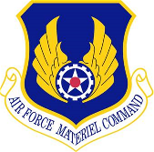




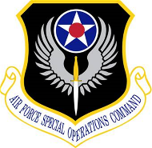

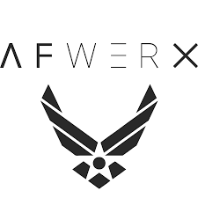






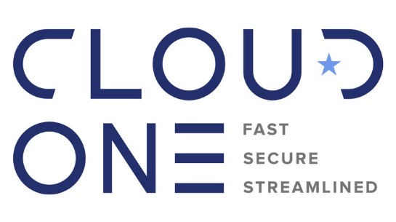


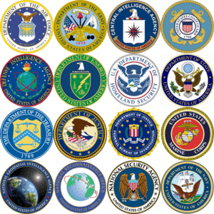


Software Ecosystem: Multiple Innovation Hubs, One Platform
Software Factories
DoD-wide Enterprise Services
43+
PMOs/PEOs across Services
Ventures / Non-Traditional / Startups
S&T
AF Ventures
Defense Industrial Base (all inclusive)
Other Agencies

Slide 16
SAFe questions?
Memo on SAFe (still in effect until drastic changes are made to SAFe and its implementation): https://software.af.mil/wp-content/uploads/2019/12/CSO-MFR-on-Agile-Frameworks-12282019.pdf
Previous Ask Me Anything on SAFe: https://zoom.us/recording/play/c3HAHzfNH2lEd5bcGEZaKihI0pjT7N28w2IAdzcHrfdYuKFC4jKanhKAbNFOZ4yE?continueMode=true&startTime=1576257977000&autoplay=true
Why now?
Several DoD programs and DIB vendors are using SAFe today and need help to understand either how to adjust or fix their issues
Scaled Agile reached out to CSO Office to see how they could potentially address our concerns and demonstrate how SAFe could evolve to be aligned with DoD’s vision

Slide 17
DevStar (Dev*Ops)
DIB SWAP (3 May 2019)
“…not all software is the same”
Type A: COTS
Type B: Customized Software
Type C: COTS HW/Operating Systems
Type D: Custom Software/Hardware
I highly recommend everyone read this report!
Continuous Development
T_{K} = (Dev)
Hours - Days
Industry culture and policy evolved; blurred lines between dev and ops environments
Continuous Integration
T_{K+1} = (Dev)(Ops)
2 weeks – 1 month
Continuous ATO
T_{K+2} = (Dev)(Sec)(Ops)
Security culture and policy evolved; baked into automated pipeline
+ hours
Continuous Safety
T_{K+3} = (Dev)(Sec)(Safety)(Ops)
+ months
Continuous Airworthiness
T_{K+4} = (Dev)(Sec)(Safety)(AW)(Ops)
+ months
Must consider and evolve these elements as well to enable more automated pipeline!
Continuous Test
T_{K+5} = (Dev)(Sec)(Safety)(AW)(DT/OT)(Ops)
+ years
Continuous Weapons
T_{K+6} = (Dev)(Sec)(Safety)(AW)(DT/OT)(Seek Eagle)(Ops)
+ months
Continuous Nuclear
T_{K+7} = (Dev)(Sec)(Safety)(AW)(DT/OT)(Seek Eagle)(Nuc)(Ops)
Keys to Success
Evolve culture and policy
Early stakeholder involvement
Automated vs. manual process
+ months
…
…
T_{K+n} = (Dev)*(Ops)
Embedded weapon systems require DevStar (Dev*Ops)
Notes:
Need for speed…but embedded systems present DevOps process challenges
The “quality” communities should demand more rigor, higher transparency, and a voice early in the design.
Stakeholders need not be agile/DevSecOps expert…focus on responsiveness and quality!

Slide 18
What metrics matter?
Development
Operations
1
Inputs
2
Value Creation
3
Recovery
Tickets
Capability
Development
Latent
Defect
Escape
Defect
Resolution
Backlog
Defect
Baseline
Deployment
Failure
Resume
Operations
Source: NDIA Continuous Iterative Development and Sustainment Working Group
Feedback Loops:
Discovery (unit, integration, system, DT, OT, ops)
User feature request
Adversary tactics change
Prioritized capability roadmap
Notes:
Example metrics:
Lead time
Cycle time
MTTD (Mean Time to Detection)
MTTR (Mean Time To Repair)
Change failure rate
(additional quality metrics)

Slide 19

How do we bridge the gap?
Team 8: DevSecOps Real-Time/Embedded systems (est. Q1 2020)
Vision: Push the DevSecOps art-of-the-possible for embedded/real-time applications. Leverage pathfinder initiatives with real-world programs to mature supporting technology and stakeholder culture. Applies to legacy, current, and future programs.
Contributors: Air Force Sustainment Center (AFSC), Georgia Tech Research Institute, Wind River, SpaceX, etc.
Needs:
Mature data rights and architecture models for continuous, system-level CI/CD across prime, suppliers, and government teams
Ideas to automate/streamline quality controls (e.g., safety, airworthiness, nuclear, etc.) in development pipeline
Strategy:
Mission Critical: Open architecture + Kubernetes/Istio
Real-Time & Safety-Critical: DAL-certified Linux + hardware emulation/simulation + automate controls
Promising preliminary lab results
Embedded
Non-Safety Critical
Embedded
Safety Critical
Emulation/Simulation
Certifiable Linux
Airworthiness
Mix-Criticality
Cyber

Slide 20
Cloud Native Access Point
Provided by a managed service by Platform One.
Brings a full Zero Trust stack enforcing device state, user RBAC and Software Defined Perimeter/Networks based on Google BeyondCorp concepts
Allows access to Cloud One (AWS GovCloud and soon Azure Government) and Platform One without a bCAP or IAP
Allows access from thick clients on BYOD, government owned devices (both mobile and desktop) while enforcing their device states by using AppGate as a zero trust client.
Allows for VDI options for zero / thin clients
Enables internet egress at IL5 in Dev enclaves
Brings DMZ/Perimeter stack with break and inspect, IDS/IPS, WAF capability, full packet capture as an elastic Cloud based stack
Brings Single Sign On with various DoD PKI options and IL2 MFA options.
Centralizes/Aggregates logs and pushes to CSSP

Slide 21









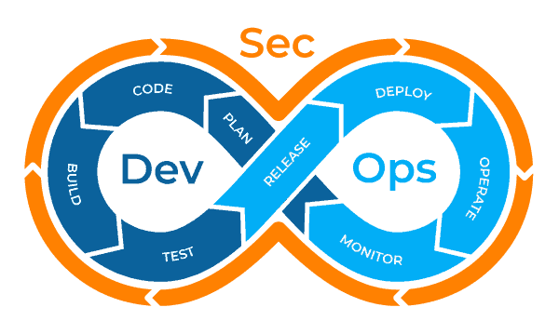







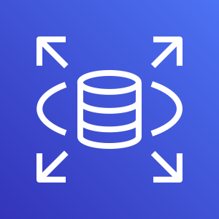


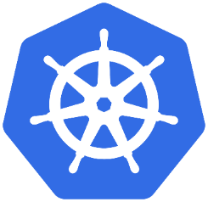


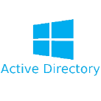
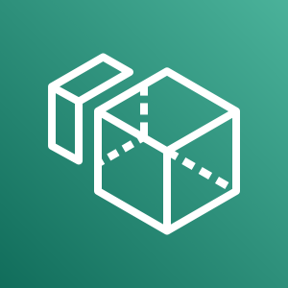
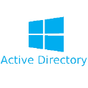
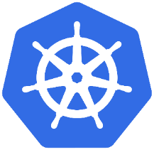
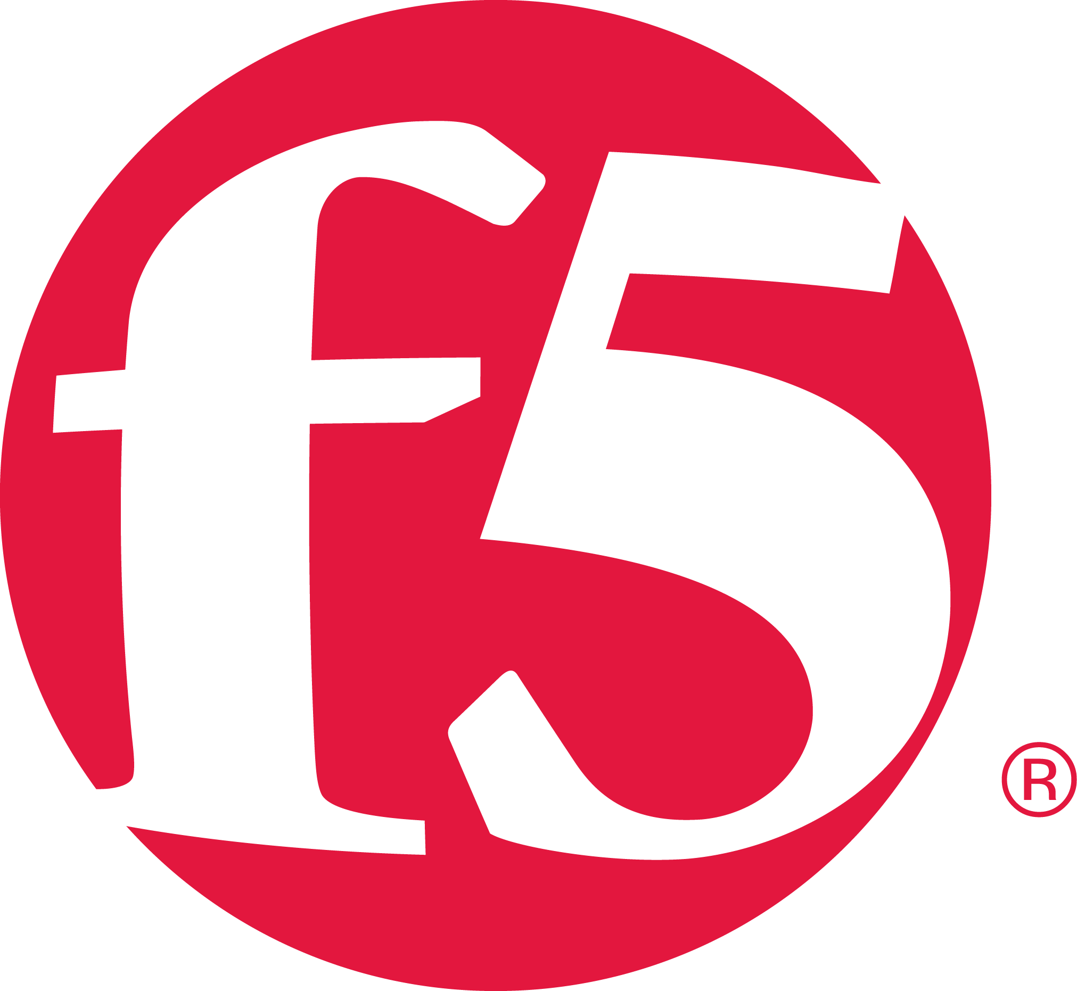
Cloud Native Access Point
(CNAP)
AWS GovCloud
Internet Egress for Thick & Mobile Endpoint
HTTP/80 HTTPS/443 by default
Ingress VPC
SDP VPC
HTTPS/443
Egress VPC
Internet
Zeek
Dev VPCs
Dev VPCs
Mattermost
HTTPS
Port 443
Network intrusion detection for CNAP Ingress
Live analysis of network events
Custom alerting to network activities
Enables full packet capture
SSO HTTPS
Port 443
Dev VPCs
HTTPS
Port 443
Break / Inspect TLS
Thick Endpoints / Mobile
Comply2Connect enforced on required endpoints for VPN connectivity. Endpoint origins such as DoDIN can be whitelisted from C2C.
MFA via DoD PKI, CAC, ECA, PIV-I, etc.
SAML
DevSecOps Pipelines
Central Services
Ingress Palo Alto
Border firewall protection
Layer 1-7 security
Break & inspect TLS for non AppGate destined traffic
L7 WAF-like functionality to detect protocol anomalies and vulnerability exploits
Only ingress point for CNAP access
HTTP/80 HTTPS/443 by default
Zeek
Network intrusion detection for Dev egress
Live analysis of network events
Custom alerting to network activities
Enables full packet capture
HTTPS/443
Cloud
Services
Container Orchestration
AppGate (SDP VPN)
Zero Trust VPN
Micro-segmentation of resources
Enforces Comply2Connect
Utilizes RBAC for access
Provides mTLS tunnel
Outbound traffic mirrored to Zeek
Interface Traffic Mirror
HTTPS
Port 443
HTTPS/443 by default
Dev VPCs
Dev VPCs
Zero Client / Thin Client
Test VPCs
No AppGate Client, no C2C
MFA to VDI via DoD PKI, CAC, ECA, PIV-I
Internet
Public Services VPC
DevSecOps Pipelines
Central Services
Egress for Dev VPCs and resources
Egress for Thick Endpoints / Mobile clients connected to AppGate VPN
Used to pull software updates and patches
Break / Inspect TLS
HTTPS
Port 443
Cloud
Services
Container Orchestration
Any Endpoint for Chat only
Keycloak (SSO)
Provides Single-Sign On (SSO)
SAML, OpenID, Oauth
LDAP / AD Integration with Internal and External Identity Providers
MFA Auth
HTTPS & HTTP by default
Port 443 & 80
All elements of the CNAP are monitored and controlled by CSSP services
TLS break & inspect at both Palo Altos, (ingress and egress) with logs forwarding to CSSP
Full log aggregation throughout all elements of DAP stack using Fluentd
Integrated with elements of C5ISR CSSP capability
JAMF (Policy)
Provides OS X / IOS Policy Enforcement
Dev VPCs
Egress Palo Alto
Border firewall protection
Layer 1-7 security
Break & inspect TLS
Only egress for internet traffic
HTTPS
Port 443
Dev VPCs
Staging VPCs
IDAM VPC
VDI VPC
DevSecOps Pipelines
Central Services
C5ISR CSSP VPCs
LDAPS
Port 636
Cloud
Services
Container Orchestration
PCoIP Port 4172
Vulnerability Scanning
Configuration Management
Incident Management & Response
User Monitoring / Insider Threat
Intrusion Prevention / Detection
Log Aggregation, Analysis, & NOC/SOC
INFOCON / CPCON Notification
Active Directory
Identity provider for SSO
Teradici PCoIP
Adheres to RBAC
Utilizes PCoIP protocol to prevent data exfil capabilities
Dev VPCs
Dev VPCs
Prod VPCs
External Identity Providers
Mmgt. VPC
Management Tools
Logging (EFK stack)
SIEM
Scanning
Configuration Management
Administrative Tools
DevSecOps Pipelines
Central Services
CAP / IAP / BCAP
Used as last resort only
GitOps and CaC should be leveraged to push from Dev/Test to Staging/Prod
Cloud
Services
Container Orchestration
Log Data – aggregated to EFK stack Management VPC for all VPCs throughout CNAP

Slide 22
Container Hardening Process
New container is requested. Container is assigned to a “DSOP developer” as its “maintainer”.
If Commercial Product (COTS):
DSOP Developer reaches out to vendor to explain on-boarding process and gather download.yaml file to automate the download of binaries with dependencies and Dockerfile to rebuild container.
Vendor has to rebase container on Universal Base Image (UBI) (RHEL based) STIGed.
If Open Source Product (OSS):
DSOP Developer defines best source to gather dependencies and Dockerfile.
DSOP Developer rebases container to UBI STIGed if possible.
DSOP Developer creates download.yaml to automate the download of binaries/dependencies to decouple download from Dockerfile.
DSOP Developer creates new repository in DCCSCR repository for vendor and the container
DSOP Developer configures CI/CD orchestrator to detect code change in DCCSCR to automate build/scanning pipeline.
DSOP Developer pushes Dockerfile and download scripts to DCCSCR which triggers CI/CD phases (see next slide)

Slide 23
Container Hardening Process (Continued)
CI/CD orchestrator run multiple phases once it detects a code change in DCCSCR:
Phase 1 – Download: will download all dependencies by using download.yaml in DCCSCR which connects to various Internet sources to pull the updated binaries and Dockerfile. This will be an ephemeral container running on « Development Namespace »
Phase 2 – Build: will launch an ephemeral container in « Build namespace » to build the container offline to ensure no download is done by the Dockerfile.
Phase 3 – Copy artifacts: artifacts are pushed to Artifact repository/container registry
Phase 4 – Scanning: will launch ephemeral containers in « Staging Namespace » to scan using Twistlock and Anchore. Additionally, it uses the OpenSCAP VM to scan the container for STIG findings.
Phase 5 – CVE analysis: aggregate all findings from Twistlock, Anchore, OpenSCAP into a single list of findings.
Phase 6 – Hardening: Developer tries to harden / mitigate findings and loop back to phase 1 at each code change.
Phase 7 – First time only or if new CVE found – MANUAL review: Authorizing Official reviews the findings and whitelist approved CVEs. If new CVE, break the build and go to manual review again.
Phase 8 – CVE whitelist: The whitelist UI tool is used to approve CVEs for the SPECIFIC container image (the whitelist is PER container). AO authorizes merge request into DCCSCR for the container.
Phase 9 – Signing: signed (GPG) with approved DCAR private key.
Phase 10 – Publishing: pushed to DCAR with all necessary artifacts (Scan results, GPG keys, README, LICENSE etc.)

Slide 24
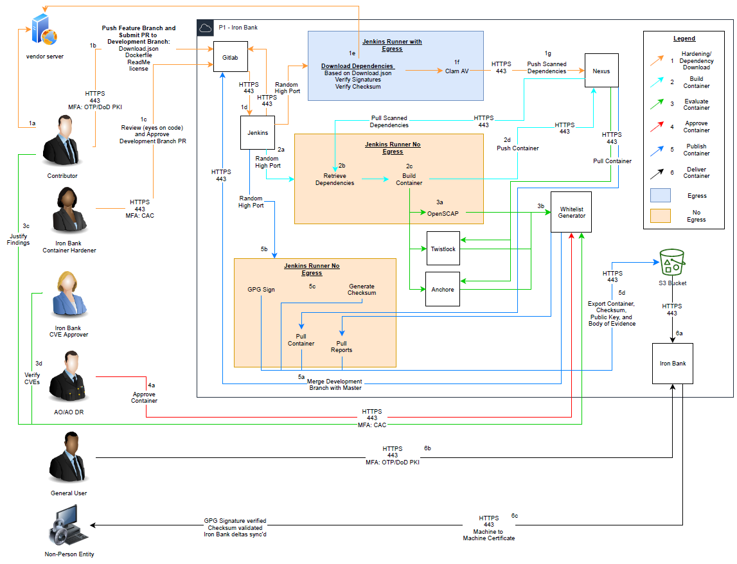
Container Hardening Process (Continued)
https://software.af.mil/wp-content/uploads/2020/03/Iron-Bank-Flow.pdf

Slide 25
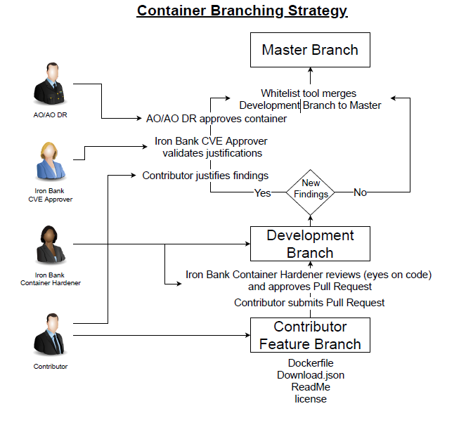
Container Hardening Process (Continued)
https://software.af.mil/wp-content/uploads/2020/03/Iron-Bank-Branching.pdf

Slide 26
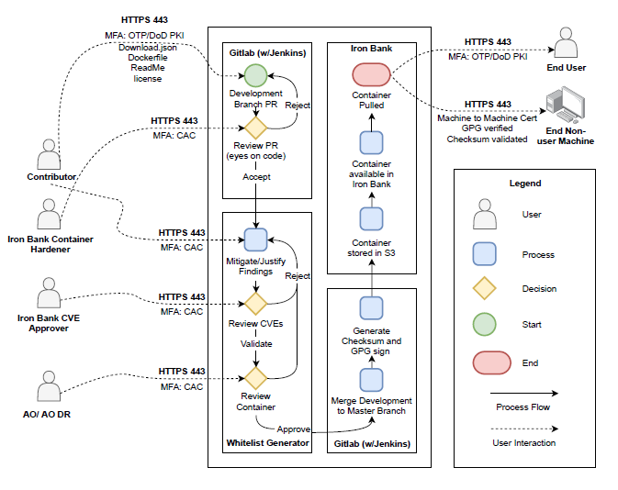
Container Hardening Process (Continued)
https://software.af.mil/wp-content/uploads/2020/03/Iron-Bank-Process-Flow.pdf

Slide 27
New Chat Capability Thanks Platform One!
Special Thanks to Matt Huston and Jeff McCoy and the rest of Platform One for setting up in 28H a dedicated Cloud enclave with Kubernetes and our DevSecOps stack to deploy MatterMost
URL is: https://chat.collab.cdl.af.mil/
Can provide chat and file sharing capabilities. Can integrate with Zoom and we are looking at bots and various plugins as well.
The chat is up to FOUO (IL4) in private Teams only (not public teams/chats which is IL2)
Doesn’t need CAC, just MFA using Google/Microsoft Authenticator
Accessible from GFE or BYOD (mobile and web based) from within or outside DoDIN!
10,000+ active users

Slide 28
DSAWG DevSecOps Subgroup
Voting members:
SAF/CSO (chair), DoD CIO/DISA and A&S
Advisory members:
Air Force, Navy, Army, IC representation, 4th estate representation, OSD A&S, Joint Staff, RMF Tag Team
Companies joining to provide advices: Microsoft, RedHat, VMWare, Pivotal, Splunk, Rancher, Anchore, Stackrox, Sysdig, FFRDC (SEI/MITRE) + Linux Foundation + more TBD.
Key deliverables:
Documents (members can be in multiple teams):
Team 1: DoD Enterprise DevSecOps Ref Design (and following updates)
Team 2: Kubernetes SRG
Team 3: Containers SRG
Team 4: Cloud Native Access Point
Team 5: Work with NIST (Ron Ross) on DevSecOps new publication based on Ref Design.
Team 6: Continuous ATO Guidance, defining the:
Accreditation requirements to accredit DevSecOps pipeline process and the various layers
Accreditation requirements to accredit teams to use the accredited pipelines
The expected deliverables / artifacts of pipelines/platforms + automation eMass etc.
Team 7: Write the required training for SCAs and ISSMs and AOs to understand how to adopt to new cATO guidance

Slide 29
Kubernetes/Containers with Real-Time Systems (1)
Existing use cases:
We put Kubernetes/Istio on F-16 jets but this wasn’t on real-time OS: https://youtu.be/YjZ4AZ7hRM0
Real-time on Kubernetes? Yes it is possible! https://www.youtube.com/watch?v=R_JOhWlwsXo
K3S on cars! https://youtu.be/zmuOxFp3CAk. Also checkout BMW with OpenShift.
Check out:
new DevStar page: https://software.af.mil/dsop/dsop-devstar/
New RFI on embedded systems: https://beta.sam.gov/ (W9133L-20-SS-AATC-01)
Discussions with WindRiver, Opensource Linux with Kernel patches and OpenShift (4.4 has a real-time beta)
Certifications:
DAL-A/B/C/D?
MVP with B-21/F-35/GBSD/F-16/SWEG/AATC/AFRL/SpaceX:
Bring Kubernetes and Istio on real-time OS, including Kubelet etc.
Hardware in the loop automation with DevSecOps dev/test on Cloud One then pushed to on-premise Hill AFB for HW test.
New CoP RTOS/embedded Workgroup: interested? Email af.cso@us.af.mil to join.

Slide 30
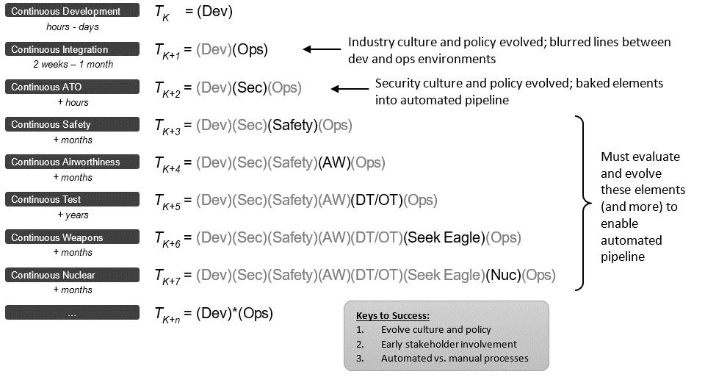
Kubernetes/Containers with Real-Time Systems (2)

Slide 31
What is GitOps?
Based on Infrastructure as Code concepts, makes Git the single source of truth of the desired state of your Infrastructure, Platform and Applications.
Benefits:
Everything is code: infrastructure, networking, configuration, sealed secrets etc.
Auditability & Compliance, including least privilege and need to know
Consistent deployments and rollback (no drifts between environment)
Configuration Management enforcement
Disaster Recovery
Baked-in security: Kubernetes clusters pulls from Git. CI/CD won’t have access to production clusters. Removing human from production environments
Declarative manifests and playbooks
Options:
Argo CD, Flux as FOSS. Projects are merging into a single FOSS.

Slide 32
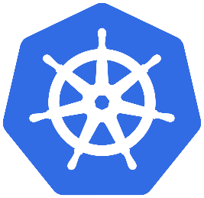
Basic GitOps Team Architecture
Each team would get one (or more) “Service Repository” and a “Manifests” Repository (for least privilege)
Git Repo: Service New Branch (Containers etc.)
CI/CD Pipeline
Reviewer(s)
Git Repo: Services
Master Branch (Containers etc.)
CI/CD Pipeline
Artifacts Repository
Dev
Commits
Triggers
Peer review
Accept & Merge code
Triggers
Push
Reject change
pulls
Git Repo: Manifests New Branch
CI/CD Pipeline
Reviewer(s)
Git Repo: Services
Master Branch
Dev
Commits
Triggers
Peer review
Accept & Merge code
pulls
Reject change

Slide 33
Learn More About GitOps
GitOps at Scale with Jenkins and Argo CD on Kubernetes: https://www.youtube.com/watch?v=4owbdHzfyMY
Intro: Flux - Stefan Prodan, Weaveworks & Alexis Richardson, Weaveworks: https://www.youtube.com/watch?v=u8usjpl3jWM
Tutorial: Everything You Need To Become a GitOps Ninja - Alex Collins & Alexander Matyushentsev: https://www.youtube.com/watch?v=r50tRQjisxw

Slide 34
What is the DoD Enterprise DevSecOps Initiative?
Joint Program with OUSD(A&S), DoD CIO, U.S. Air Force, DISA and the Military Services.
Technology:
Avoid vendor lock-in at the Infrastructure and Platform Layer by leveraging FOSS with Kubernetes and OCI containers
Creating the DoD Centralized Artifacts Repository (DCAR) of hardened and centrally accredited containers: selecting, certifying, and securing best of breed development tools and software capabilities (over 170+ containers) - https://dccscr.dsop.io/dsop/ and https://dcar.dsop.io
Baked-in Zero Trust Security with our Sidecar Container Security Stack (SCSS) leveraging behavior detection, zero trust down to the container/function level.
Leveraging a Scalable Microservices Architecture with Istio as Service Mesh and baked-in security
Leveraging KNative to avoid lock-in to Cloud provider Serverless stacks
Bringing Enterprise IT Capabilities with Cloud One and Platform One – Cloud and DevSecOps as Managed Services capabilities, on-boarding, contract vehicles and support!
Standardizing metrics and define acceptable thresholds for DoD-wide continuous Authority to Operate
Massive Scale Training with Self Learning Capabilities (train over 100K people within a year) and bring state of the art DevSecOps curriculum
Created new Agile contracting language to enable and incentivize the use of DevSecOps

Slide 35
Training Options
Our latest training videos from DAU available at: https://software.af.mil/training/
Check out our curated YouTube videos on Kafka, Kubernetes, Service Mesh, Microservices, Cloud etc. at https://software.af.mil/training/
NEW: Federal employees/Military personnel (limited number of seats, free of charge): reach out to us at af.cso@us.af.mil if you want to pilot the access to the O’Reilly Online Learning Platform (all O’Reilly content + virtualized K8S env)!
Platform One Training/On-Boarding Options:
1-day training Session: introduction to DevSecOps. Overview and understanding of the vision and activities
A 3-day introduction to LevelUP DevSecOps tech stack. Hands on code and User-Centered Design (UCD) to deploy your first demo app to production
A several week full on-boarding, that concludes with an MVP ready for production
A several month full on-boarding, that concludes with your platform team being able to support your own DevSecOps applications for development and production
Customized training options (both at our locations or on your premises)
Follow the CNCF channel: https://www.youtube.com/channel/UCvqbFHwN-nwalWPjPUKpvTA

Slide 36
Cloud One/Platform One Timelines
Container Hardening: 40 containers today, will be at 170+ containers by July 2020
Cloud One:
Cloud One Dev IL5 environment up mid February 2020. Cloud One production IL5 is ready
IL 6 Dev/Test available 1Q 2020. Production waiting on DoD Provisional ATO
Platform One:
Basic Ordering Agreements: protests are cleared, we can use the BOAs today
IL5 DevSecOps Development Environment at Scale by mid-February 2020
IL2/6/FENCES/C2S DevSecOps Managed Environment available today
“Push button" Platform One Factory for IL-2, IL-5, S, C2S, and FENCES available June 2020
“Push button" Platform One Factory on premise available Aug 2020
Internet Facing Cloud VPN IL5: Feb 2020 (doesn’t need CAP/IAP)
Can deploy on C2S/SC2S as needed by programs today
Can deploy on FENCES (SAP) as needed by programs by March 2020
Can deploy on premise as needed today
Training Sessions are available now (preferred in San Antonio, TX or Colorado Springs, CO)
Self Learning Capability: Access is available today with few options (D2IQ/O’Reilly)
Managed (« Opinionated ») DevSecOps stack with various options (Source code repo/Artifact repo/Chat/CI/CD/Cyber etc.), should be available around June 2020

Slide 37
“A Digital Workforce for a Digital Air Force“
Incredible work from Hannah Hunt (Kessel Run Chief of Staff) who pulled together Digital Workforce recommendations across the AF for enlisted, officers and civilians.
The nine recommendations that follow provide actionable steps the U.S. Air Force can take to achieve the needs of a Digital Air Force, and are explained in more detail in the report.
Develop a Software Career Track for military and civilian personnel that isn’t a dead-end
Appoint a Chief Talent Officer for the Air Force
Build an organization of trust and put hiring and promotion authority at the lowest level of decision-making
Automate personnel processing with commercially-available business tools.
Track real hiring metrics that matter
Make it easier to promote top talent internally (and compensate them for it)
Build meaningful recruitment campaigns that attract top talent
Redefine training requirements for a digital workforce
Be less risk-averse up front and be willing to terminate personnel within probationary periods
We will provide the draft for review in the next few weeks.

Slide 38
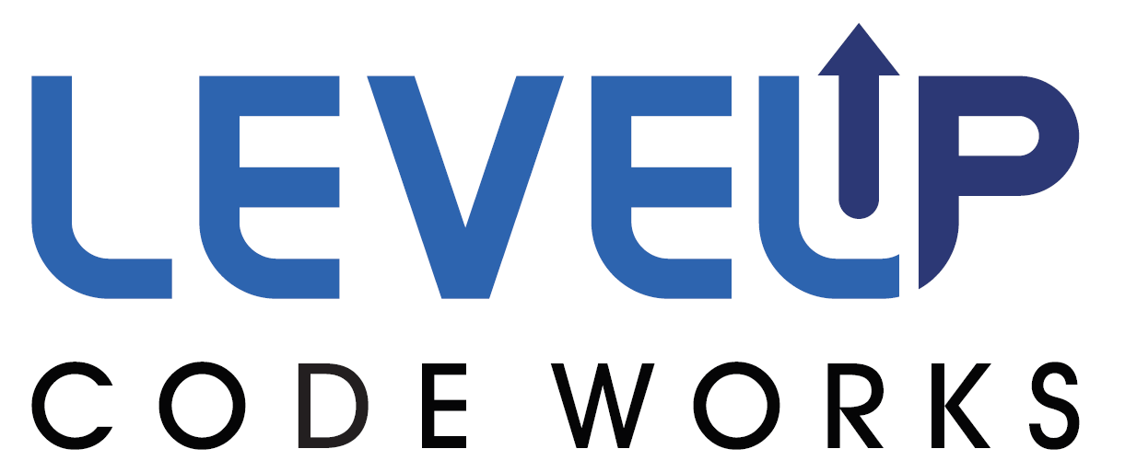
Key “DevSecOps” Ingredients
Abstracted: to avoid drifts, be agnostic to environment (Cloud/on-premise/classified/disconnected…) and prevent lock-ins with Cloud or Platform layers, we leverage CNCF compliant Kubernetes and OCI compliant containers - open source stacks with U.S eyes on code and continuous scanning,
GitOps / Infrastructure as Code (IaC): no drift, everything is code (including configuration, networking etc.) Instantiate entire stack automatically,
Continuous Integration/Continuous Delivery pipeline (CI/CD): fully containerized and using Infrastructure as Code (IaC),
Hardened Containers: hardened “Lego blocks” to bring options to development teams (one size fits all lead to shadow IT)
Software Testing: mandated high test coverage,
Baked-in Security: mandated static/dynamic code analysis, container security, bill of material (supply chain risk) etc.
Continuous Monitoring:
Centralized logging and telemetry,
Automated alerting,
Zero trust, leveraging Service Mesh as Sidecar (part of SCSS), down to the container level,
Behavior detection (automated prevention),
CVE scanning,
Chaos engineering: Dynamically kills/restarts container with moving target defense.

Slide 39
“Infrastructure as Code” Benefits
The “Infrastructure as Code” concept is a critical DevSecOps ingredient to ensure that production environments do not drift from development/testing environments. No human should make changes in production environments. Changes should only be made in source code and redeployed by the CI/CD pipeline.
No drift between environments, whether classified/disconnected/Cloud/on-premise,
Immutable,
Replicable,
Automated,
No human in production environments: reduces attack surface (disable SSH etc.), insider threat and configuration drifts,
Everything is code: including playbooks, networking, tests, configuration etc.

Slide 40
Key “Continuous Security” Ingredients
Kubernetes hardening.
Automated injection of Sidecar Container Security Stack (SCSS) into all containers/pods running without manual action.
RBAC/SSO/SELinux enabled
Compliant with CIS Kubernetes Benchmark, mapped to NIST 800-53
Nodes, master, etcd are hardened.
Automated backups of cluster and persistent storage!
Sidecar Container Security Stack (SCSS):
Automated centralized logging and telemetry with Elasticsearch, Fluentd, Kibana (EFK),
Service Mesh (Istio):
Baked-in zero trust model down to the container level!
Strong identities automatically generated using certificates.
mTLS tunnel injected across all container communication
Whitelist enforcement, Layer 7 load balancer etc
Container security: Continuous Scanning, Alerting, CVE scanning, Behavior detection both in development and production (Build, Registry, Runtime) with Twistlock (looking into StackRox and Sysdig)
Container security and insider threat (custom policies detecting unapproved changes to Dockerfiles) with Anchore
Automated STIG compliance with OpenSCAP.

Slide 41
Keeping up with Kubernetes & Open-source projects
This slide will be regularly updated with new exciting projects that our team has discovered or is using and want to share with you for your awareness
Real-time on Kubernetes? Yes it is possible! https://www.youtube.com/watch?v=R_JOhWlwsXo
K3S on cars! https://youtu.be/zmuOxFp3CAk
Istio: Service Mesh (check out the Service Mesh slide in the DevSecOps Introduction slide deck): https://github.com/istio/istio
KUI: kui is a K8S terminal with visualization by and for developers - https://kui.tools - https://github.com/IBM/kui
ITER8: Iter8 supports cloud-native, automated canary releases and A/B testing, driven by analytics based on robust statistical techniques. https://iter8.tools https://github.com/iter8-tools/docs
SOLSA - Operator based solution composition: https://github.com/IBM/solsa
Operator Hub – Kubernetes Operators https://operatorhub.io/
Federated Mesh and Compliance in ISTIO: https://preliminary.istio.io/blog/2019/isolated-clusters/
Trusted Identity: Trusted Service Identity is closing the gap of preventing access to secrets by an untrusted operator during the process of obtaining authorization for data access by the applications running in the public cloud. https://github.com/IBM/trusted-service-identity
New Container Image Encryption OCI Spec: https://github.com/containers/ocicrypt
Container Image signing: https://github.com/IBM/portieris

Slide 42
DevSecOps Stack implements Zero Trust!
Identities:
strong NPE identities are automatically managed by Istio (Service Mesh) for each container to enable zero trust down to the container level.
Non-NPE identities are using strong identities with DoD PKI
Devices:
Developer endpoints are using VDI options or approved endpoints images
Applications:
Apps are containerized and behind the Service Mesh which enforces Zero trust with strong identities per pod/container and .
Infrastructure:
Kubernetes is centrally hardened and continuously monitored with centralized logs and telemetry.
SCSS monitors container signatures and container state
SCSS brings Behavior detection and CVE continuous scanning
Network:
mTLS tunnels are automatically injected across all containers/pods by SCSS.
Data:
Data is always encrypted in transit and leverages FIPS encryption at rest.

Slide 43
F.A.Q
How many DoD programs are currently using Platform One? The number is continuously evolving but we have about 39 pathfinders across DoD working with us in various ways. We also know our hardened containers are used across the U.S Government and even commercial organizations.
How broad is the internal adoption of vendor products from the DCAR? Very wide as it is a very streamline process to get software accredited DoD wide. We are actively working with about 40+ companies/products at the time;
What is the communication policy to alert vendors of changes made to the SCSS, DCAR or Platform One programs? We provide information usually within a week on the software.af.mil website and do bi-weekly Ask Me Anything sessions where we share our updates.
Is there an SLA for vendors to respond to changes? Ideally within 30 days after change is announced. That being said, it is critical that vendors automate the push of their software container updates and dependencies in real-time with as little delay as possible.
Can we get access to a pre-production environment (including the deployment pipeline with security scanning gates) in order to test and validate our application? Not at this time, you must setup your own environment using the same scanner that we are using to be able to proactively let us know of a new CVE.
To what extent does a vendor application have control over the auto-scaling capabilities of the underlying Kubernetes platform? You provide the Helm charts or Kubernetes Operators or Kubernetes manifest with your application so you can certainly push for the right configuration settings there but they can certainly also be customized by each DoD Program.
When we release a new version of our application to DCAR, how do the deployed instances get updated? Pathfinders will automatically download DCAR container updates (assuming they are connected) every day, up to twice a day. Then each DoD program can decide if they automatically use “latest” tag in their deployments or not.

Slide 44
F.A.Q
How frequently can vendors update their containers within DCAR? As much as you want. We certainly do NOT want to be behind your commercial releases.
We were told that all dependencies must run in a container, thus we need to provide additional containers when they do not already exist in DCAR. That is correct, if a container doesn’t exist in DCAR, you must bring it with you. Same for ANY dependency. You must assume the container build will happen offline. If you know the container is part of our list of 170+ containers we will be supporting, reach out to our team to ask if it is being done and if not, you can provide it to the team and they will take over the ongoing maintenance of the container.
If a container needs storage, how should we create it? As long as you use Kubernetes native APIs to provision the storage in YAML, it should work for DoD. You can certainly use PVC etc.
What percentage of applications are written in Java, .NET or another language? It is impossible for us to tell but our new greenfield applications will use modern programming languages whenever possible, including Java, Python, Go etc.
Why is the DevSecOps initiative pushing teams to use containers and microservices? A modular architecture allows for decouple teams and flexible/elastic use of technologies. Refer to our training and slides on containers and Kubernetes.
Can containers and microservices be used for weapon systems or real time systems? Yes. We can patch Kubernetes and the Linux Kernel to run as a real-time system. Microservices can be used for any system, including weapons. In fact, it was used in our demonstration of putting Kubernetes on F16 jets on legacy hardware!
Since we can benefit from the c-ATO from Platform One, will we still need our own ATO on top of this environment? It depends; If you deploy containers and use Kubernetes in production, you will benefit from full reciprocity to run your application. If the application is not containerize and run on legacy environments, you will reuse the ATO of that environment or you might need to have a dedicated ATO for that environment. We will work with you and your Authorizing Official to define the best path forward.
How long does it take to get access to an environment on Cloud One or Platform One with c-ATO? It depends of the complexity of the environment and if the containers for the tools you need already exist but, if you’re not highly opinionated on tools, we can usually have an environment up within a couple of weeks.

Slide 45
Why Kubernetes / Containers?
One of the most critical aspect of the DevSecOps initiative is to ensure we avoid any vendor lock-in so the DoD mandated:
Open Container Initiative (OCI) containers (no lock-in to containers/container runtimes/builders)
Cloud Native Computing Foundation (CNCF) Kubernetes compliant cluster for container orchestration, no lock-in to orchestration options/networking/storage APIs.
SaaS vs COTS/FOSS containers:
SaaS requires FedRAMP certification and will limit you to unclassified environments (mostly IL5 for FedRAMP high) which doesn’t satisfy most needs for DoD programs. Often takes up to 1 year.
COTS/FOSS as containers: can be sold as a managed service deployed in DoD cloud environments (including classified clouds) on Kubernetes and can be accredited at multiple classification levels, within weeks, by following the container hardening guide and vendor on-boarding process!
Containers are immutable and will allow the DoD to centrally accredit and harden containers (FOSS, COTS, GOTS) (think of a true gold disk concept but that actually scale and works).
Continuous Monitoring is a critical piece of our Continuous ATO model and the Sidecar Container Security Stack (SCSS) brings those capabilities with Behavior, Zero Trust and CVE scanning.
Kubernetes will provide:
Resiliency: Self-healing so containers that crash can automatically be restarted,
Baked-in security: thanks to automatic injection of our Sidecar Container Security Stack (SCSS) to any K8S cluster with Zero Trust,
Adaptability: containers are “Lego” blocks and can be swapped with no downtime thanks to load balancing and modern routing (A/B testing, canary release etc.),
Automation: thanks to our Infrastructure as Code (IaC) and GitOps model,
Auto-scaling: if load requires more of the same container, K8S will automatically scale based on compute/memory needs,
Abstraction layer: ensure we don’t get locked-in to Cloud APIs or to a specific platform as K8S is managed by CNCF and dozens of products are compliant with its requirements.

Slide 46
Questions about DCCSCR/DCAR?
Containers accredited in the DCCSCR/DCAR repository have DoD-wide reciprocity across classifications.
Source code repo: DCCSCR: https://dccscr.dsop.io/dsop
Source code repo: DCCSCR Infrastructure as Code (IaC): https://dccscr.dsop.io/levelup-automation/aws-infrastructure
DCAR (Container binaries): https://dcar.dsop.io
Programs can contribute containers that have enterprise benefits to DCCSCR/DCAR and our team will accredit them DoD-wide and maintain them.
If you need to accredit/harden custom containers Platform One can do this as a “managed service”, Pay per use model.
We are building a container which automatically download container updates into your K8S cluster, checks signatures and pushes them to your local registry (agnostic to your artifact repo)
Questions? Email af.cso@us.af.mil

Slide 47
Contribute your containers or get your COTS/FOSS containers accredited!
Containers are the easiest way to get accredited DoD-wide across multiple classifications today.
Containers accredited in the DCCSCR/DCAR repository have DoD-wide reciprocity across classifications.
Check out the vendor on-boarding guide at: https://dccscr.dsop.io/dsop/dccscr/tree/master/contributor-onboarding
By being compliant with the DoD Enterprise DevSecOps Container Hardening guide (last version at https://software.af.mil/dsop/documents/), you can have your containers (FOSS/COTS/GOTS) accredited for DoD use.
Recommend using the hardened STIG UBI7/8 images (Universal Base Image which is lightweight RHEL but doesn’t need a license) from the DCAR repo as your base image so you don’t have to STIG your container base OS: https://dcar.dsop.io. Use the binary signed version on DCAR, do not rebuild it.
Key aspects:
Your container must be able to build offline. If you have dependencies, provide them with an automated script that will download new updates of those dependencies. ALL DEPENDENCIES must be included
Container must be able to be built offline, no downloads in Dockerfile!
Dockerfiles must be provided and be able to be rebuilt. If you have a different base OS (not UBI), it must be STIGed.

Slide 48


Understanding the DevSecOps Layers
Continuous Monitoring
Leverages the Sidecar Container Security Stack
Development Teams can build software/microservices leveraging hardened containers
YOU
Application
Layer
Brings baked-in security and
Microservices architecture enablement
Platform
One
Service Mesh
Layer
Fully containerized, leverages DoD approved containers from DCAR
Development Team selects tools from 172 approved containers or custom containers
Continuous Integration / Continuous Delivery
(CI/CD) Layer
CNCF compliant Kubernetes (K8S)
Includes Site Reliability Engineers (SREs) etc.
Development Team selects between approved K8S stacks
Platform
Layer
Environment Agnostic
Cloud One Preferred for unclassified (IL2, IL4, IL5)
Or SC2S/C2S/FENCES
Or on-premise/classified environments
Cloud One
Infrastructure
Layer

Slide 49
Questions about Sidecar Container Security Stack?
Baked-in Zero Trust security down to the Container/Function level with Istio (Envoy) and Knative,
Automated centralized logging and telemetry with Elasticsearch, Fluentd, Kibana (EFK),
Container security: Continuous Scanning, Alerting, CVE scanning, Behavior detection both in development and production (Build, Registry, Runtime) with Twistlock (looking into StackRox and Sysdig),
Container security and insider threat (custom policies detecting unapproved changes to Dockerfiles) with Anchore;
Automated STIG compliance with OpenSCAP.

Slide 50
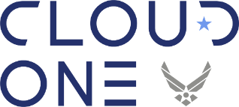
“Cloud One” vs “Platform One by LevelUP”
Cloud One:
Centralized team to provide Cloud Infrastructure with baked-in security to DoD programs. Think of it as the Infrastructure team with baked-in security, CSSP and Authority to Operate (ATO).
Only contact Cloud One if you only need Cloud compute/storage, if you need a DevSecOps stack (on Cloud One or not), contact « Platform One by LevelUP »
Point of Contact: DOLCE, JOSEPH G Maj USAF - joseph.dolce@us.af.mil; Watson, Todd M Lt Col USAF todd.watson@us.af.mil
Platform One by LevelUP:
Centralized team to provide DevSecOps/Software Factory with baked-in security to DoD Programs. Think of it as the Platform Team with the ability to deploy a DevSecOps (Kubernetes compliant) Platform and CI/CD pipeline with a Continuous ATO (c-ATO). You select from accredited tools to accelerate your ability to focus on delivering mission capabilities.
Contact Platform One if you need both Cloud and DevSecOps capabilities!
Point of Contact: Slaughter, Rob Maj USAF - rob.slaughter@afwerx.af.mil; Bryan, Austen R Capt USAF - austen.bryan.1@us.af.mil;

Slide 51
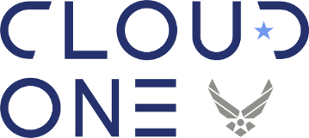
Questions about Cloud One?
Air Force Cloud Office with turnkey access to AWS GovCloud and Azure Government at IL2, 4 and 5. IL6 available by February 2020.
Simple “Pay per use” model with ability to instantiate your own Development and Production VPCs at various Impact Levels within days with full compliance/security and a baked-in ATO.
Enterprise Solution: we provide the guardrails to the cloud in a standard manner so you can focus on your mission
Fully Automated: All environmental stand-up is managed by Infrastructure as Code, drastically speeding up deployment, reducing manual work, and human error
Centralized Identities and Single-Sign-On (SSO): one login across the Cloud stack
Internet facing Cloud based VPN to connect to IL5 enclaves with a Virtual Internet Access Point (coming within February 2020).
DevSecOps Focused: secure, mission driven deployments are built into the framework to ensure self-service and seamless deployments. Leverages Zero Trust model.
Proactive Scaling and System Monitoring: Mission Owners can see all operational metrics and provide rules and alerts to manage each mission their way
Accreditation Inheritance has been identified in the AF-Cloud One eMASS accounts (AWS & Azure) to include inheritance from the CSP, USAF, DoD and CSSP. All that’s left for the mission is the controls that are unique to them.

Slide 52
Questions about “Platform One by LevelUP”?
Merged top talent across U.S. Air Force from various Factories (Kessel Run, SpaceCAMP and LevelUP).
Helps instantiate DevSecOps CI/CD pipelines / Software Factories (DoD-wide) within days, on any environment, at various classification levels.
Manages Software Factories for Development teams so they can focus on building mission applications.
Provides DoD-wide DevSecOps contract vehicles (Basic Ordering Agreement (BOA)) for Cloud Service, Talent and Licenses. Enables awards every 15/30 days with bulk discounts.
Decouples Development Teams from Factory teams with DevSecOps and Site Reliability Engineer (SRE) expertise.
Partners with Cloud One to provide IL2, 4, 5 and 6 access but also uses C2S/SC2S and various on-premise environments!
Self-learning and training capabilities to enable teams move to Scrum/Kanban/eXtreme Programming (XP) Agile practices.
Leverages the DoD hardened containers while avoiding one-size-fits-all architectures.
Fully compliant with the DoD Enterprise DevSecOps Initiative (DSOP) with DoD-wide reciprocity and an ATO. Leverages Zero Trust model.
Hardens the 172 DoD enterprise containers (databases, development tools, CI/CD tools, cybersecurity tools etc.).
Provides Software Enterprise Services with Collaboration tools, Cybersecurity tools, Source code repositories, Artifact repositories, Development tools, DevSecOps as a Service, Chats etc. Programs pay per use.

Slide 53
“Platform One by LevelUP” Managed Services “A La Carte”
Hardened Containers Options
Delivery of hardened enterprise containers with accreditation reciprocity (existing containers only).
Delivery of custom hardened containers as needed.
Continuous Integration / Continuous Delivery (CI/CD) Options
Delivery of existing hardened Kubernetes/OpenShift/PKS playbooks (full Infrastructure as Code).
Delivery of a turnkey CI/CD pipeline (Software Factory) with complete « Infrastructure as Code » to instantiate on any environment (development teams picks the tools from the approved hardened containers) on various classified/unclassified environment.
Training/On-Boarding Options
1-day training Session: introduction to DevSecOps. Overview and understanding of the vision and activities.
A 3 day introduction to LevelUP DevSecOps tech stack. Hands on code and User-Centered Design (UCD) to deploy your first demo app to production.
A several week full on-boarding, that concludes with an MVP ready for production.
A several month full on-boarding, that concludes with your platform team being able to support your own DevSecOps applications for development and production.
Customized training options (both at our locations or on your premises).
Contracting Support Options
Ability to leverage the DevSecOps BOAs (Cloud Services, Talent and Licenses).
Enable access to DevSecOps engineers/SREs Full-Time-Equivalent (FTEs) (Medics/Counselors) to assist Programs.

Slide 54
Questions about the DevSecOps Basic Ordering Agreements (BOAs)?
Covers Cloud Services, Talent and Licenses so DoD programs can get everything they need for a DevSecOps environment, completely turnkey.
Pay per use models.
Not selected yet? We will have quarterly on-boarding events for new vendors/award opportunities!
Aims to award each order within 15 days (!!!)
Available to the entire Department of Defense
Point of Contact:
License BOA: Jernigan, Patrice D CIV USAF AFLCMC CCS (USA) patrice.jernigan.1@us.af.mil
Cloud Services BOA: Lovell, Jesse L CIV USAF (USA) <jesse.lovell.1@us.af.mil>
Services BOA: Paul, Christopher C 2d LT USAF AFLCMC (USA) christopher.paul.3@us.af.mil
Generic:
Paul, Christopher C 2d LT USAF AFLCMC (USA) christopher.paul.3@us.af.mil
Slaughter, Robert C Maj USAF (USA) robert.slaughter.3@us.af.mil
Wyler, Victoria R Capt USAF SAF-AQ (USA) victoria.r.wyler.mil@mail.mil

Slide 55
Questions about the Agile / SAFe Memo?
The CSO signed a Memorandum for Record on Nov 26th 2019, sent to all PEOs and PMs regarding the use of DevSecOps and Agile and highly discouraging from using rigid, prescriptive frameworks such as the Scaled Agile Framework (SAFe).
Why?
DoD is still using Waterfall or Water-Agile-Fall so until we can truly implement basic Scrum/Kanban, there is nothing to « SCALE ». Agile should be applied across the entire Program, not just the development team, that includes: Contracting, Program Management, Reporting to leadership (no EVM) etc!
You cannot scale if you don’t have the “basics” right. At best, such frameworks put us at risk to fall back to what we know and go back to Waterfall because of their “mapping”.
SAFe might potentially be an useful framework for teams that do not use DevOps/DevSecOps but a key principle of DevSecOps is to decouple work and teams and the only synchronization required should be across Product Owners. Teams shouldn’t have to coordinate if they use a Service Mesh/Domain Driven Design/Microservices model. This doesn’t require a rigid framework. If you’re having issues implement this, you’re not implementing a true DevSecOps model.
Take what is best from any framework and make it work for your team! Certifications aren’t always the answer!
Fundamentally, the main “goal” of Software development is NOT to be « SAFE », it is to INNOVATE and CREATE. You do not create by not taking risks… unless you’re part of the far less than 5% of AF software that implements safety critical functions… it is quite the opposite:
« Continuous Learning: Fail Fast but don’t Fail twice for the same reason! » - Small incremental changes which mitigate risks and create safe conditions to implement rapid changes.
SAFe isn’t used by any successful software commercial organization (Facebook, Google, Netflix, etc.).
Looking to coordinate your Product Owners’ work? Multiple models exist. This shouldn’t impact the developers.
Don’t believe us? Listen to the Agile fathers: http://www.smharter.com/blog/safe-a-collection-of-comments-from-leading-experts/

Slide 56
Thank You!
Nicolas Chaillan
Chief Software Officer, U.S. Air Force
af.cso@us.af.mil

